Slide 1
专题五 介词
高考英语
北京市专用

Slide 2

目 录
体系透视
重难透析
常用介词的常考用法
１.to的用法
２.with的用法
３.by的用法
４.beyond的用法
常考介词搭配
１. 介词＋名词
２. 名词＋介词
３. 动词＋介词
４. 形容词＋介词
考点针对练

Slide 3
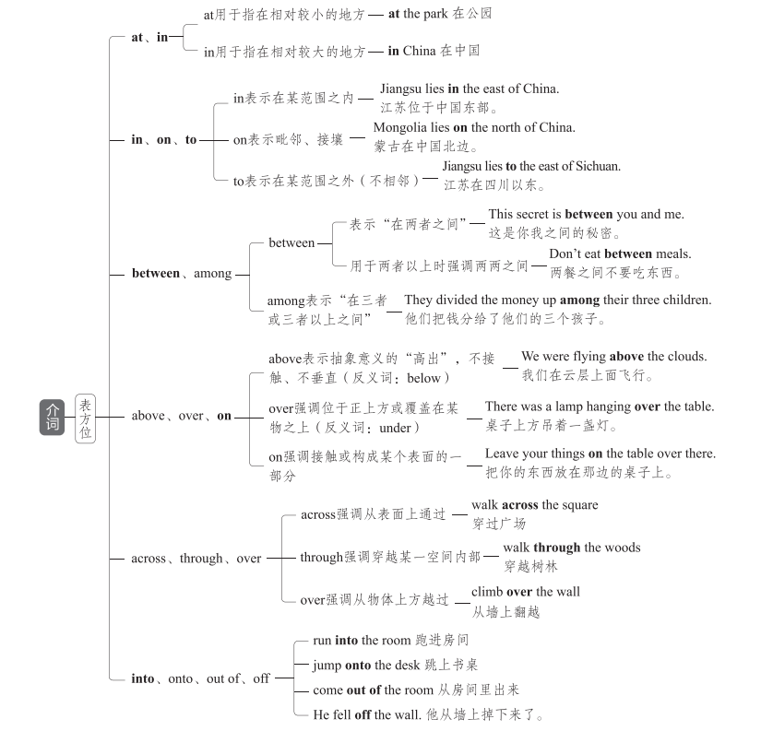
体系透视

Slide 4
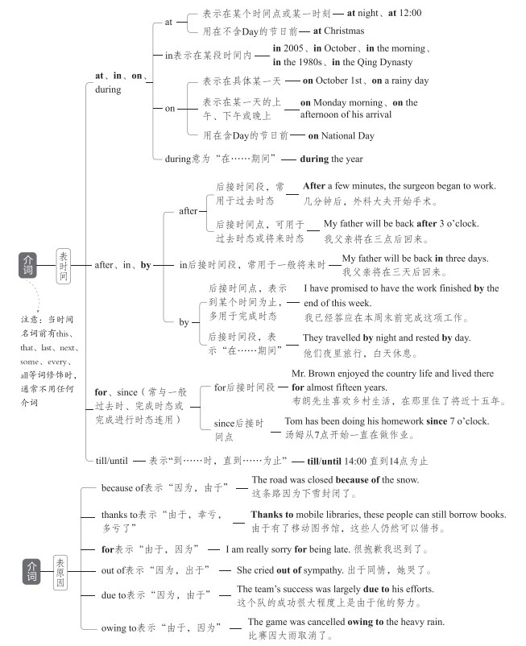

Slide 5
重难透析
常用介词的常考用法
1.to的用法
to与情感名词连用,表示“某种行动后产生的感觉”。这种表达方法表示结果,用
作状语,位于句子的前、中、后皆可。为了强调,可在前面加 much,意为“使某人非常
……的是”。
to one's delight/surprise/horror/sorrow/joy/regret=to the delight/surprise/horror/sorrow/joy/
regret of sb.
使某人开心/惊讶/惊恐/难过/开心/遗憾的是

Slide 6
2.with的用法
用法 | 例句
表示“和……在一起”“由……陪同”或“有……在场” | I have a client with me right now. 我现在有个客户。
表示两种事物之间的相应关系或齐头并进的意思 | With time passing,they have grown into big boys and big girls. 随着时间的流逝,他们长成大男孩和大姑娘了。
表示“带有,带来,带走,携带”等 | He looked at her with a hurt expression. 他带着受伤害的神情看着她。
用于构成with的复合结构 | She sat back in the chair with her eyes closed. 她闭着眼睛舒服地在椅子上坐着。
指原因或理由 | The small child trembled with fear. 小孩吓得打哆嗦。

Slide 7
3.by的用法
用法 | 例句
表示触及或抓住的人或物的部分 | He seized me by the arm.他抓住我的胳膊。
用于计量,表示“以……计” | Milk is sold by the pint, butter by the pound, and eggs by the dozen.牛奶论品脱卖,黄油论磅卖,鸡蛋论打卖。
表示程度、数量 | This one is shorter than the other by three inches.这个比那个短3英寸。
表示“按照,从……看” | By my watch, it is half past eleven. 按我的手表,现在是十一点半。
表示方式,意为“通过,凭借” | May I pay by credit card?我能用信用卡付款吗?
表示“靠近,在……旁边” | The telephone is by the window.电话在窗户旁边。
用于被动语态,表示施动者 | He was knocked down by a bus.他被一辆公交车撞倒了。

Slide 8
4.beyond的用法
用法 | 例句
表示“(时间)晚于,迟于” | Don't stay out beyond midnight.不要在外面待到午夜以后。
表示“(位置)在(或向)……较远的一边” | The small village is 20 miles beyond the town.那个小村庄在城外20英里处。
表示“非……所能及,超出……之外” | This book is beyond me.这本书我看不懂。 Her work is beyond praise.她的工作令人赞不绝口。 Our success was far beyond what we thought possible. 我们的成功远远超出了我们的估计范围。

Slide 9
常考介词搭配
1.介词+名词
类型 | 示例
at+n. | at ease放松,不拘束 at first首先 at peace和平 at present现在 at random随意 at risk有危险,冒风险
by+n. | by accident/chance偶然 by coincidence纯属巧合 by design故意 by hand用手 by mistake错误地 by no means决不

Slide 10
类型 | 示例
in+n. | in advance提前 in brief简言之 in cash用现金 in chaos一片混乱 in common共同 in danger处于危险中 in debt负债 in demand需求很大 in detail详细地 in fact事实上 in low spirits情绪低落 in particular尤其,特别 in person 亲自 in principle原则上 in public当众 in reality实际上 in relief放心地 in return作为回报 in summary总之 in trouble处于困境 in turn轮流;转而
on+n. | on a(n)...basis以……方式 on a diet节食 on a(n)...scale以……规模 on average平均 on business出差 on occasion偶尔 on duty值班 on purpose故意 on sale在售
with+n. | with ease轻易,毫不费劲地 with relief放心地 with satisfaction满意地

Slide 11
类型 | 示例
prep.+n. +prep. | as a result of由于 at the age of 在……岁时 at the sight of一看见 by means of通过,借助于 for the honor of为了……的荣誉 for the purpose of为了 in addition to除……之外(还) in case of如果 in charge of负责 in comparison to/with和……相比 in fear of害怕 in honor/memory of纪念 in line with与……一致 in need/want of需要 in place of代替 in possession of拥有 in praise of表扬 in/with reference to关于 in respect of关于 in search of寻找 in spite of尽管 in support of支持 in terms of就……而言 in the absence of缺乏 in the way of关于 on account of因为 on behalf of代表 on one's/the way to在……途中 on the basis of以……为基础 on top of在……上面

Slide 12
2.名词+介词
类型 | 示例
n.+for | affection for对……的喜爱 an excuse for……的理由 the need for对……的需要 a preference for对……的偏爱 preparation(s) for对……的准备 the reason for……的原因 the request for对……的要求 the respect for对……的尊重 the talent for……的天赋
n.+from | absence from缺席 an escape from从……逃离
n.+in | faith in对……的信心 progress in在……方面的进步 success in在……取得的成功
n.+of | lack of缺乏
n.+on | the dependence on对……的依赖 an effect/impact on对……的影响 an impression on给……的印象
n.+to | the access to进入……的通道 the answer to……的答案 the approach to……的方法 the attitude to对……的态度 the home to……的家园 the key to……的关键 the solution to……的解决办法 the introduction to对……的介绍

Slide 13
3.动词+介词
类型 | 示例
v.+about | complain about抱怨 learn about了解 set about着手做 talk about谈论 think about考虑 worry about担心
v.+as | act as充当 serve as用作 work as从事……工作
v.+at | aim at瞄准 glance at瞥 knock at敲 laugh at嘲笑 shout/yell at 冲……嚷 stare at盯着
v.+for | account for(数量上)占 apply for 申请 ask for要求 long for渴望 look for寻找 mistake...for...把……错当成…… pay for为……付钱 provide sth. for sb.为某人提供某物 run for 参加竞选 search for搜寻 seek for寻找 stand for代表

Slide 14
类型 | 示例
v.+from | differ from与……不同 judge from从……判断 learn from向……学习 result from由……引起 separate from(使)分离 suffer from遭受
v.+in | believe in相信 end in以……告终 participate in参加 result in导致 specialize in专攻
v.+of | consist of由……组成 remind sb. of使某人想起 speak of谈到
v.+on | call on呼吁 carry on继续 center/focus on集中于 depend/rely on依赖 feed on以……为食 congratulate sb. on sth.祝贺某人某事 insist on坚持 reflect on认真思考 remark on对……发表评论
v.+to | admit to承认 apologize to向……道歉 belong to属于 compare to与……相比 devote to致力于 lead to导致 refer to指;谈到 stick to坚持 turn to求助于

Slide 15
类型 | 示例
v.+with | agree with同意 argue with与……争吵 combine with与……结合 communicate with与……交流 compare with与……比较 deal with处理 provide sb. with sth.为某人提供某物 share with 与……分享
v.+adv. +prep. | catch up with追赶上 come down to归结为 come up with想出 date/go back to追溯到 do away with废除,取消 drop out of 退出 get away from远离 get down to着手处理 keep up with与……保持联系 live up to不辜负 look down on/upon瞧不起 make up for弥补 miss out on错失……机会 put up with忍受 reach out to向……伸出援手 run out of用完,耗尽 sign up for报名参加 think highly of高度评价 try out for参加……选拔

Slide 16
类型 | 示例
v.+n.+prep. | catch sight of看见 give rise to引起,导致 make fun of取笑 pay attention to注意 take care of照顾 take part in参加 take pride in为……感到骄傲 keep track of了解……的动态;与……保持联系 make allowances for考虑到 turn one's back on对……置之不理
v.+prep. +n. | bring/put...into effect实施 come into being/existence出现,存在 come to one's rescue前来营救 keep...in mind把……记在心上 put...into practice把……付诸实践

Slide 17
4.形容词+介词
类型 | 示例
adj.+about | be curious about对……好奇 be enthusiastic about对……热情 be serious about对……严肃对待 be worried about对……担忧
adj.+at | be amazed/astonished/shocked at对……感到吃惊 be bad/good at不擅长/擅长
adj.+from | be different from与……不同 be free from不受……影响 be safe from免于
adj.+for | be bad for对……有害 be convenient for对……方便 be eager for渴望 be fit for适合 be hungry for渴望 be ready for为……做好准备 be responsible for对……负责 be thankful for因……而感激
adj.+in | be absorbed in专心于 be dressed in 穿着 be experienced in对……有经验 be/get lost in沉迷于 be rich in富含 be weak in不擅长

Slide 18
类型 | 示例
adj.+of | be ashamed of对……感到羞耻 be aware of意识到 be free of免于 be proud of对……感到骄傲 be short of缺乏 be sick of厌烦 be tired of厌倦 be worthy of值得
adj.+on | be dependent on取决于 be keen on喜欢,热衷于
adj.+to | be addicted to对……上瘾 be accustomed to习惯于 be contrary to与……相反 be equal to等于 be harmful to 对……有害 be/get married to嫁给 be similar to与……相似 be unfamiliar to对……不熟悉
adj.+with | be content with 对……满足 be crowded with挤满 be familiar with对……熟悉 be filled with充满 be occupied with忙于 be patient with对……有耐心 be popular with受……欢迎 be strict with对……严格

Slide 19
考点针对练
1. The UN Chinese Language Day not only provides a unique platform ________ the world
to better understand China, but also promotes language and cultural exchanges in the world.
解析 句意:联合国中文日不仅为世界更好地了解中国提供了一个独特的平台,还促进
了世界上的语言和文化交流。provide sth. for sb.是固定搭配,意为“为某人提供某
物”,故填for。
for

Slide 20
2. As a special education teacher at the school, I was familiar _________ the challenges
David faced and was proud of his strong determination.
解析 句意:作为学校的特殊教育教师,我对戴维面临的挑战很熟悉,并为他坚定的决心
感到骄傲。be familiar with意为“对……熟悉”。
with

Slide 21
3. There, you'll find them prepared differently—more dumpling and less soup—and the
wrappers are pressed _______ hand rather than rolled.
解析 句意:在那里,你会发现它们的做法不同——皮厚汤少——皮是手工压制的而不
是擀的。by hand意为“用手工”。
by

Slide 22
4. And who do they speak English ____________? Not the pandas, even though the language
used for the medical training instructions is actually English.
解析 句意:他们和谁讲英语?不是熊猫,即使医疗培训指令使用的语言实际上是英
语。speak...to/with...意思是“对/和……讲……”,故填to/with。
to/with

Slide 23
5. A new secretary will be hired to relieve us _______ some of the paperwork.
解析 句意:我们将雇新的秘书来减轻一些我们的文书工作负担。relieve sb. of sth.意
为“帮助……减轻……”,故填of。
of

Slide 24
6. She warns of the environmental dangers facing society, and she teaches that people must
take responsibility ________ saving their environment.
解析 句意:她警告(人们)社会面临的环境危险,并教导人们必须负责拯救自己的环
境。take responsibility for doing sth.为固定搭配,意为“承担做某事的责任”。故填
for。
for

Slide 25
7. Giant pandas also serve _______ an umbrella species, bringing protection to a host of
plants and animals in the southwestern and northwestern parts of China.
解析 句意:大熊猫也作为伞护物种,为中国西南部和西北部的许多动植物提供保护。
serve as意为“充当,用作”,介词as意为“作为”。
as

Slide 26
8. Since April drinks companies have been forced to pay between 18p and 24p for every
litre of sugary drink they produce or import, depending _______ the sugar content.
解析 句意:自4月以来,饮料公司被迫为其生产或进口的含糖饮料支付每升18便士至2
4便士不等的费用,具体取决于饮料的含糖量。depend on意为“取决于;视……而定”。
on

Slide 27
9. He flew 4,700 kilometers _________ Xi'an to Kashgar on Sept. 20, planning to hike back
to Xi'an in five months.
解析 句意:9月20日,他从西安飞往喀什,飞行4,700千米,计划在五个月内徒步返回西
安。from Xi'an to Kashgar意为“从西安到喀什”。
from

Slide 28
10. Put the medicine ___________ children's reach in case it's taken by mistake.
解析 句意:把药放在孩子们够不着的地方,以防误服。beyond one's reach意为“力所
不能及的;无法达到的”。
beyond

Slide 29
11. Due to the growing popularity of environmentally-related and adventure travel, various
types _______ trips are now being classified as ecotourism.
解析 various types of意思是“各种类型的……”。
of

Slide 30
12. After careful consideration, he chose to withdraw _________ the competition.
解析 句意:经过慎重考虑,他决定退出比赛。withdraw from意为“退出(活动或组
织)”。
from

Slide 31
13. I happen to know that Tang's play The Peony Pavilion(《牡丹亭》)
is similar in some ways _______ Romeo and Juliet.
解析 句意: 我碰巧知道汤显祖的戏剧《牡丹亭》在某些方面与《罗密欧与朱丽叶》
相似。be similar to 为固定搭配,意为“与……相似”。故填to。
to

Slide 32
14. The artist was finally humbled(谦卑) by the greatest artist _______ earth, Mother Na-
ture.
解析 句意:这位艺术家最终在世界上最伟大的艺术家——大自然面前感到惭愧。on
earth相当于in the world,意为“在世界上”。
on

Slide 33
15. Some time after 10,000 BC, people made the first real attempt to control the world they
lived _______, through agriculture.
解析 句意:公元前10,000年以后的一段时间,人类首次真正尝试通过农业来控制他们
生活的世界。they lived _______为限制性定语从句,先行词为the world,将the world代
入定语从句后应为they lived in the world,所以设空处应填介词in。
in

Slide 34
16. This aging of the population is driven _______ two factors.
解析 句意:人口老龄化是由两个因素驱动的。be driven by意为“受……驱使”。
by

Slide 35
17. This level of preservation could not be achieved ____________ the participation of gener-
ations of local residents.
解析 句意:没有几代当地居民的参与,这种程度的保护是不可能实现的。此处表示
“没有”,故填without。
without

Slide 36
18. But can uniforms help improve school standards? The answer _______ this question is
not clear.
解析 句意:但是校服能帮助提高学校标准吗?这个问题的答案还不清楚。answer与介
词to连用,表示“……的答案”。
to

